Slide 1
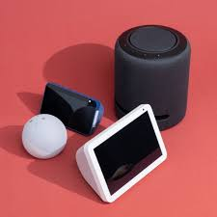
Voice chatbot

Slide 2
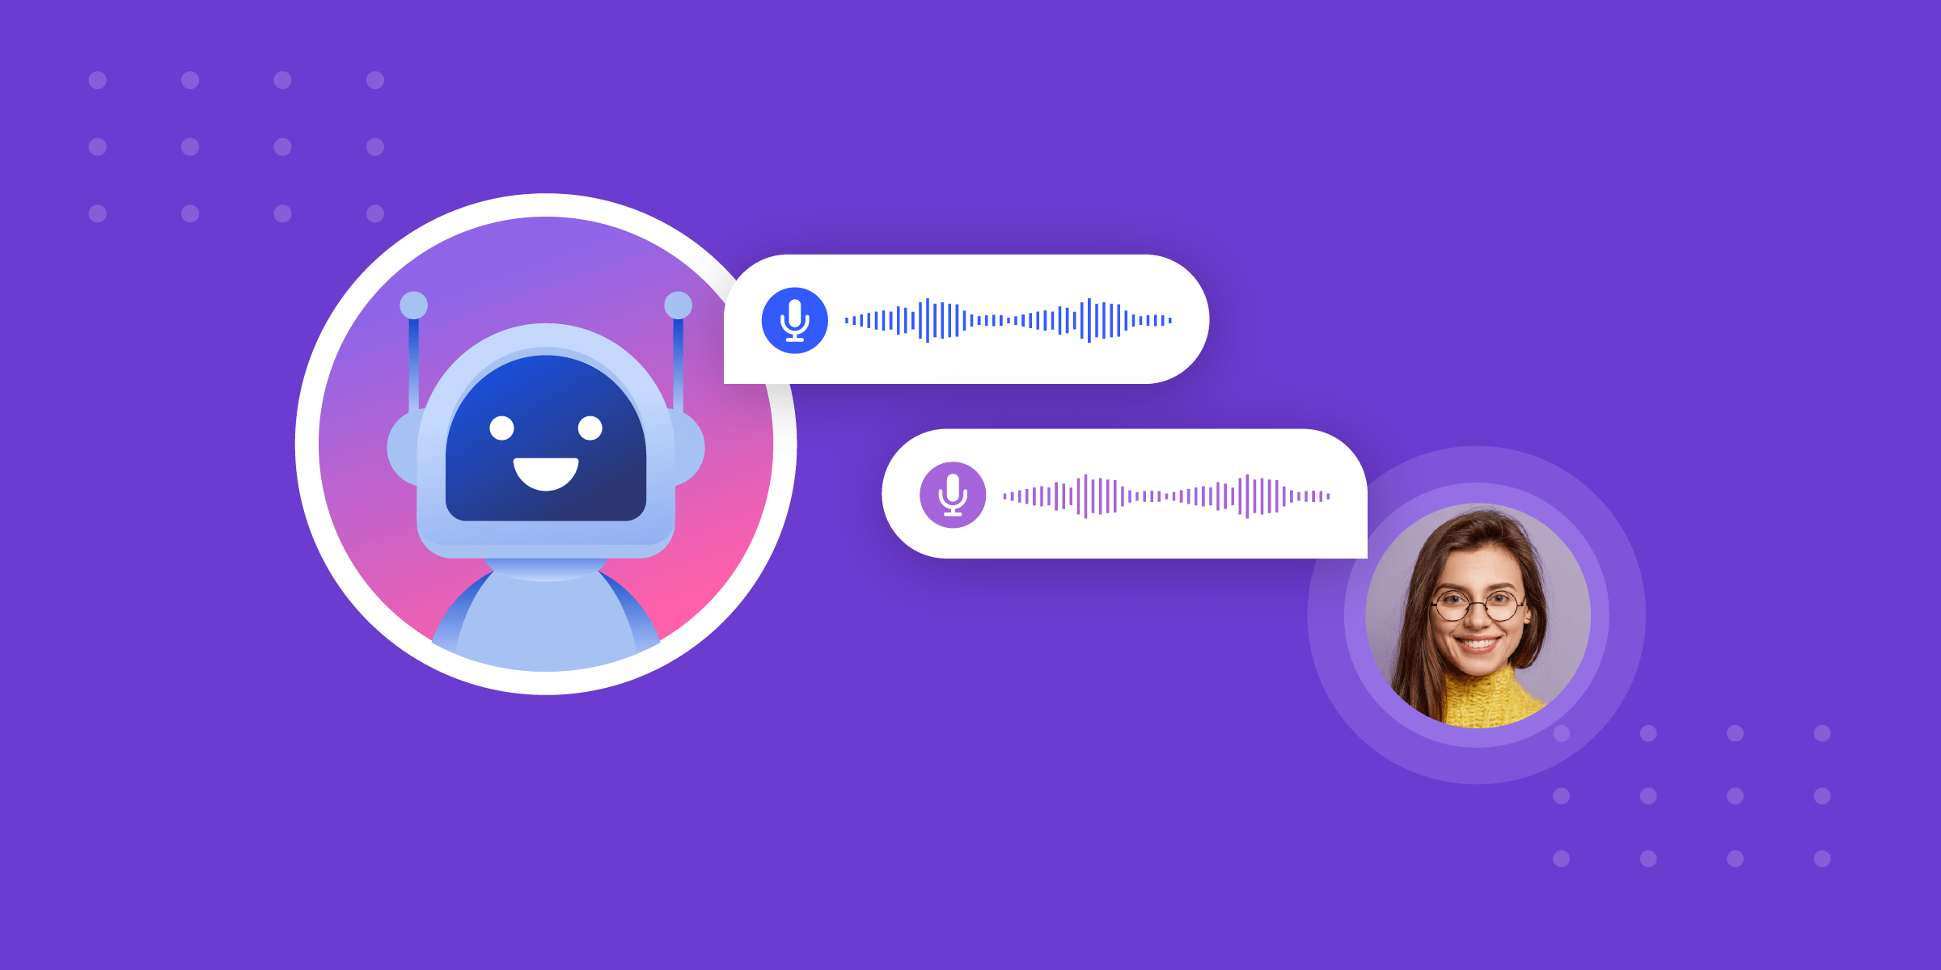
Purpose
Solution
Deployment
Problem
Resolution

Slide 3
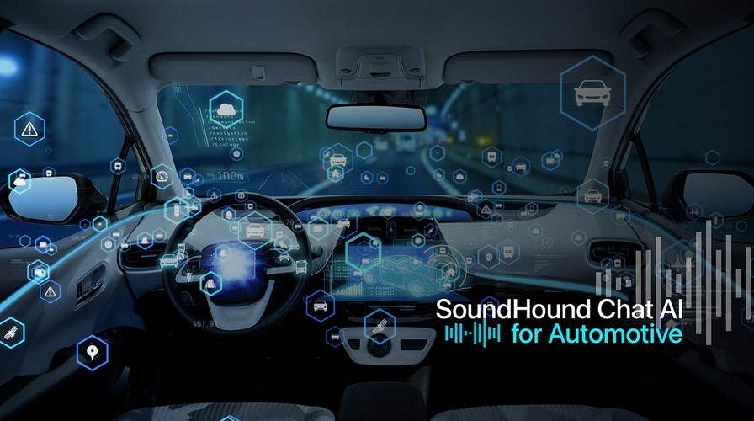
Purpose
AI Chatbot that can communicates verbally with users
Run on Android device for vehicle usage
Utilize Qualcomm chip's GPU to optimize speed

Slide 4
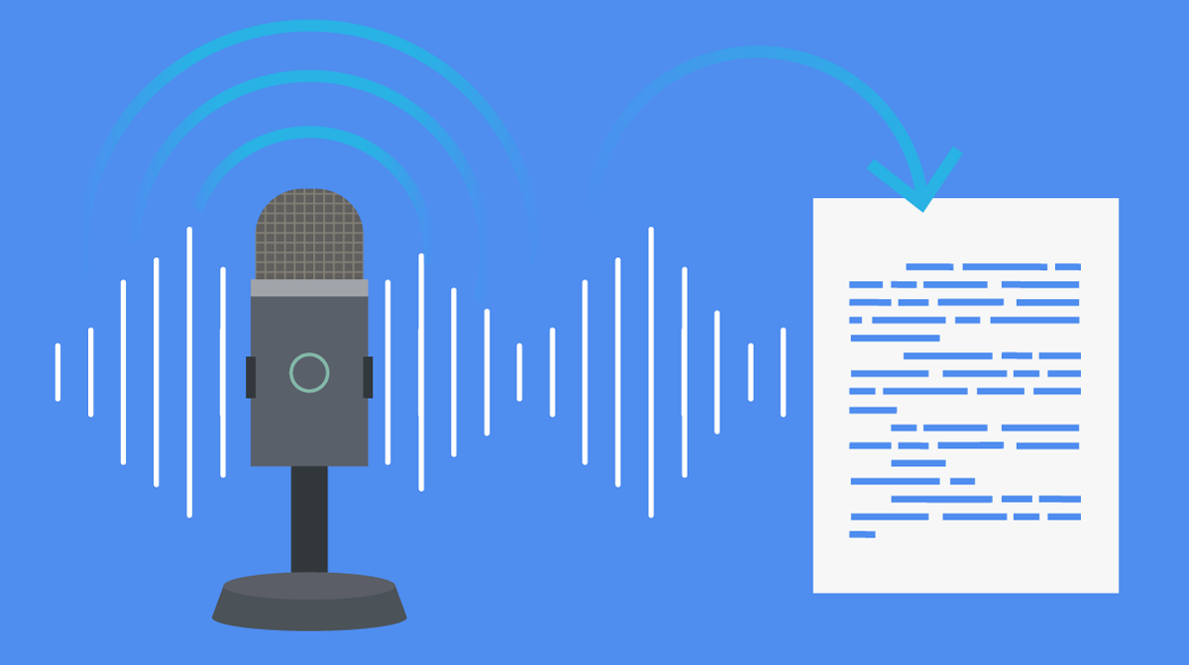

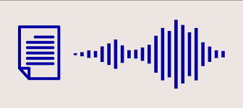
Solution
Speech To Text (STT) system to understand what user said
Large Language Model (LLM) system to answer user's input in text
Text To Speech (TTS) system to give user voice answer

Slide 5
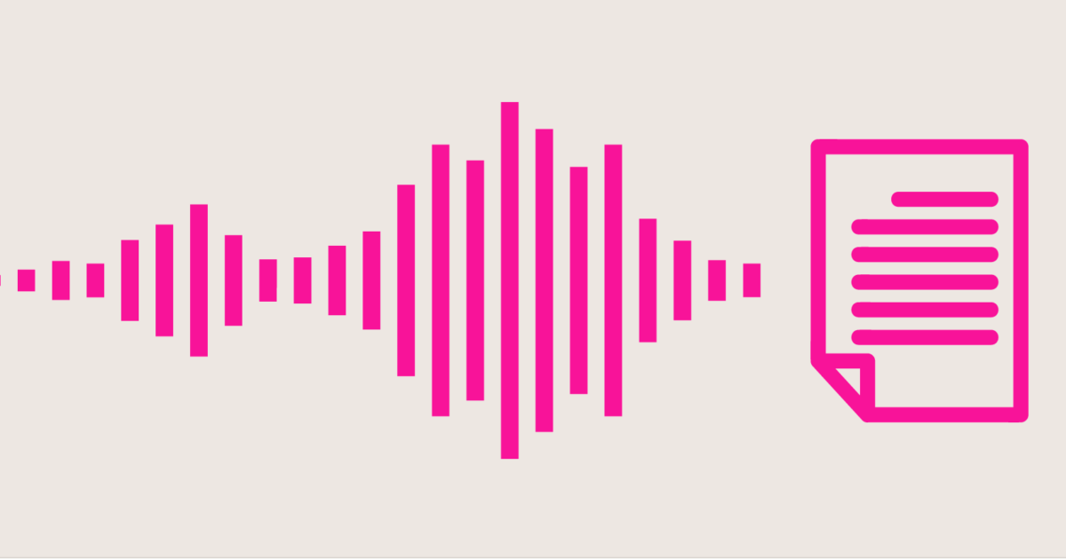
Solution
Speech To Text: Technology that converts spoken language to text
Common models: whisper (openAi-best), Google Voice, Amazon Alexa

Slide 6

Solution
Large Language Model: model used for processing, understanding, and generating human language
Common models: GPT (openAI-best), Deepseek, LLama (fastest)

Slide 7
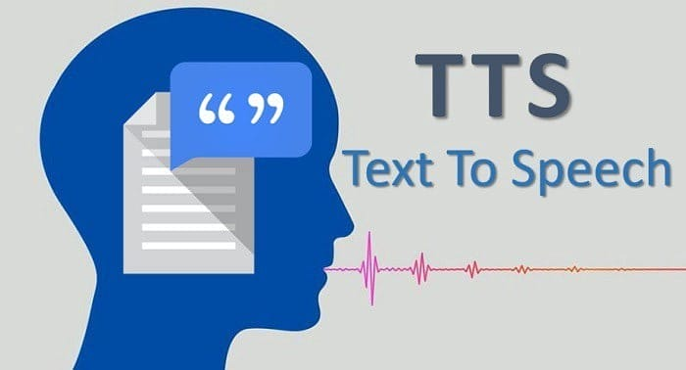
Solution
Text to Speech: technology that takes text input and produce audio speech
Common models: Whisper (openAI-best), espeak (fastest), NeMo

Slide 8
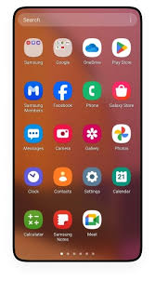
Deployment
Termux Terminal to run and compile C in Android
Whisper.cpp for quality conversion from wav to txt
LLama.cpp for optimally fast text generation.
Espeak for light weight and fast speech generation

Slide 9
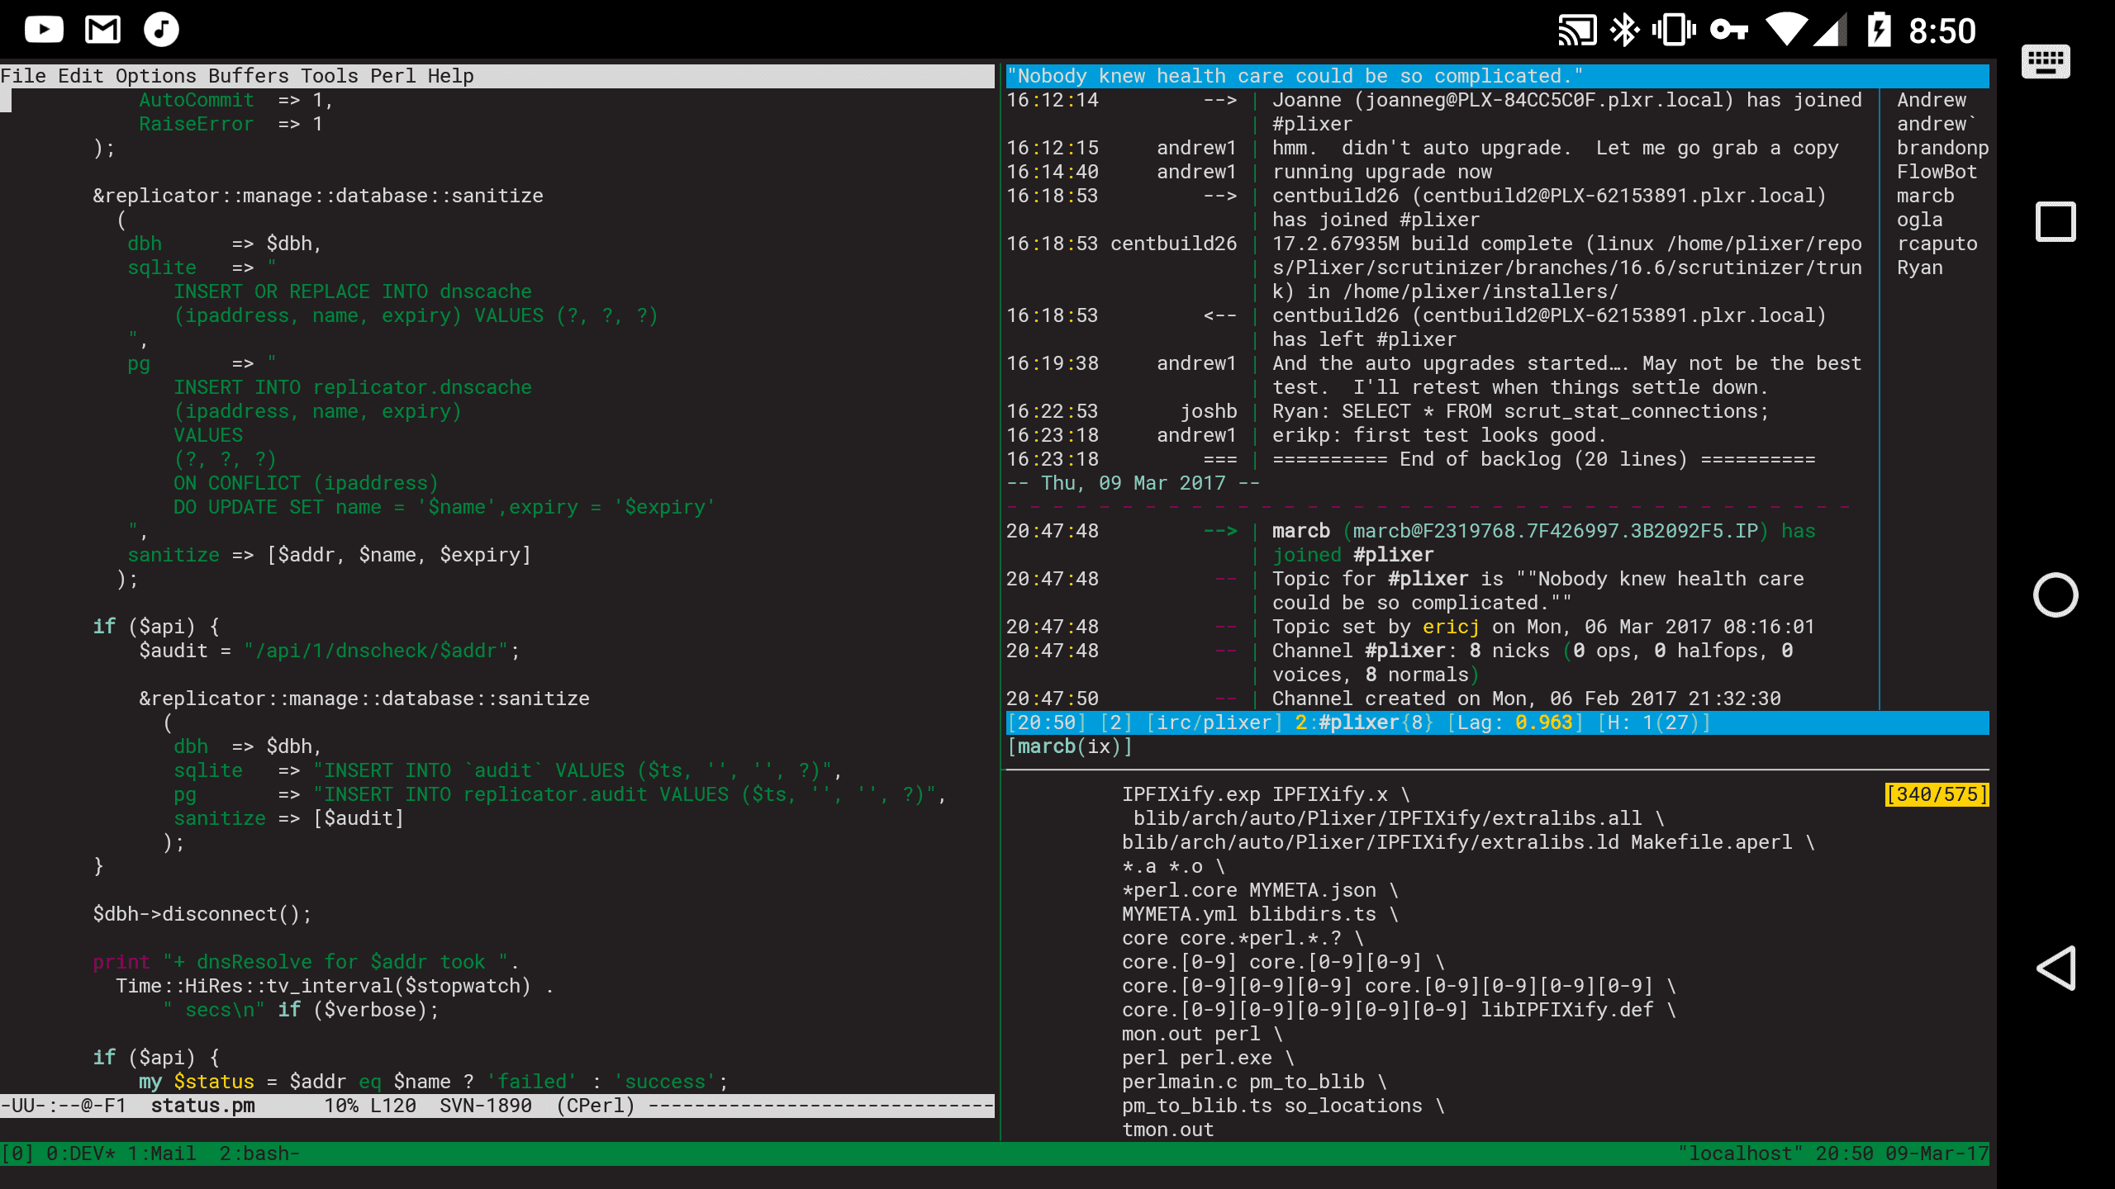
Deployment
Termux Terminal: Android App Linux Terminal simulator for compiling and running files in Linux environment

Slide 10
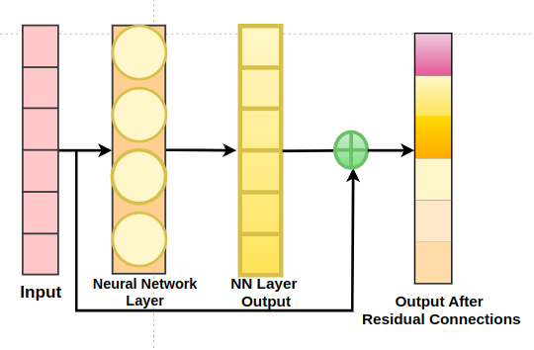
Deployment
Whisper.cpp:
Load model (bin) and audio (wav)
Preprocess data
Transformer NN classifies words based on Sound Image
Decode words from vectors
Generate text
Command:
./build/bin/whisper-cli -f <wav path> -m <model path>

Slide 11
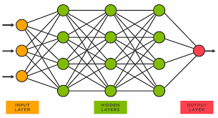
Deployment
Llama.cpp:
Load model (gguf) and text
Preprocess data (words to vectors)
Transformer NN calculates probabilities of next vector
Get highest
probability vector
Decode words from vectors
Generate text
Command:
./build/bin/llama-cli -f <wav path> -m <model path>
Model: TinyLlama-7B: Smallest with decent accuracy

Slide 12
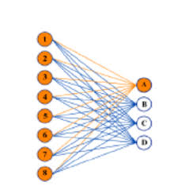
Deployment
Espeak:
Load model and text
Preprocess data
CNN calculates sound image for words
Decode audible words from images
Generate Audio
Command:
./build/bin/espeak -f <text file path>

Slide 13
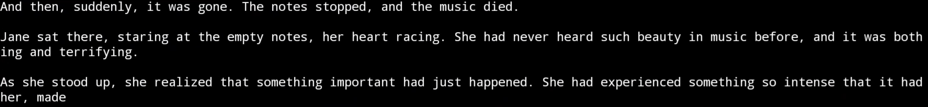
Deployment
Example:

Slide 14
Problem
Get Android OS to boot without displaying Termux
TTS can’t implement Qualcomm's GPY
LLama is slow to calculate response

Slide 15
Resolution
Quantize whisper model weights and parameters
Rewrite espeak model for running GPU

